Slide 1
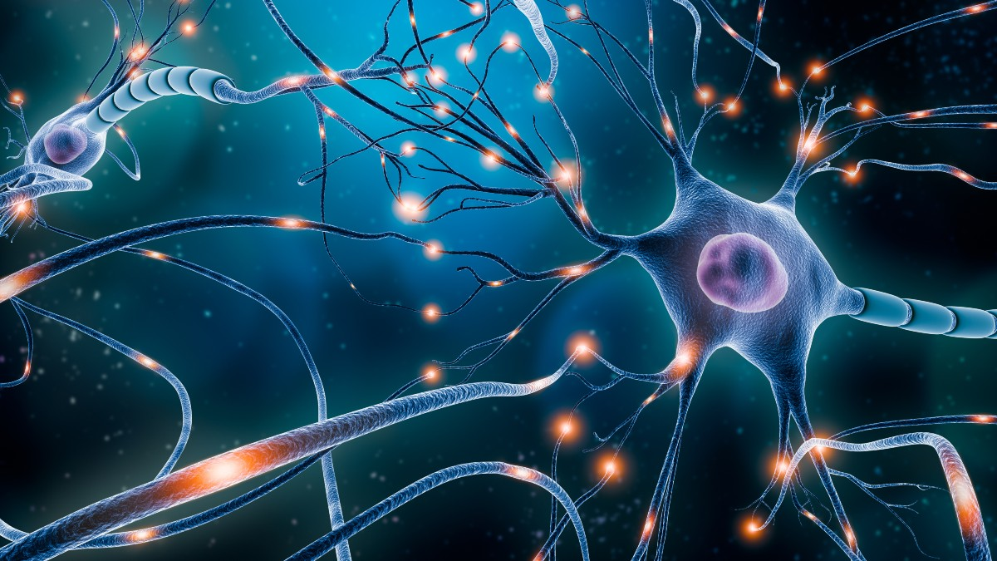

HUMAN NEURAL SYSTEM

Slide 2
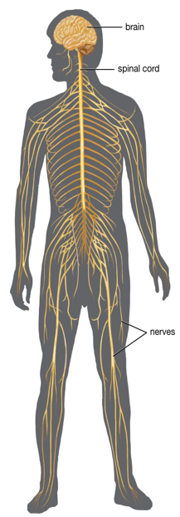
NERVOUS (NEURAL) SYSTEM
It is a system that controls and coordinates the body activities, conducts & integrates the information and responds to stimuli.
It includes brain, spinal cord & nerves

Slide 3
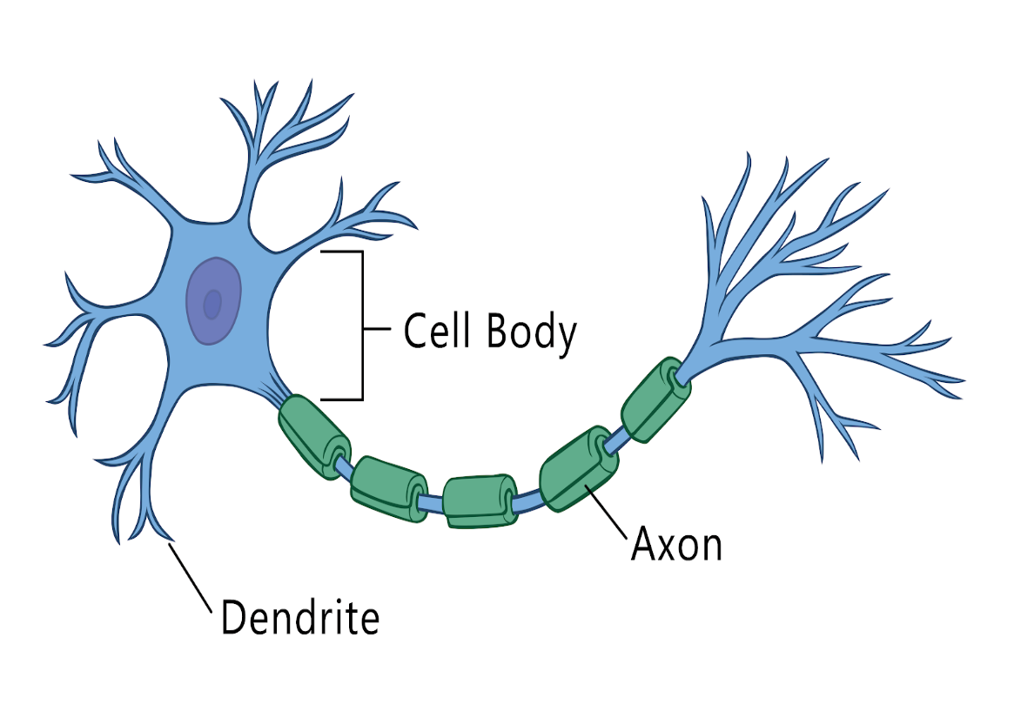
NEURON (NERVE CELL)
  Neuron is the structural and functional unit of nervous system.
  It has 3 main parts:
  Cell body (cyton)
  Dendron
  Axon

Slide 4
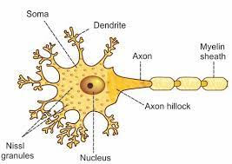
STRUCTURE OF A NEURON (NERVE CELL)
a) Cell body (cyton)

Slide 5
STRUCTURE OF A NEURON (NERVE CELL)
b) Dendron

Slide 6
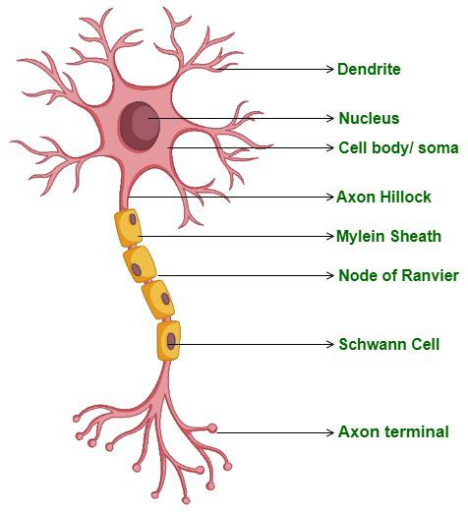
STRUCTURE OF A NEURON (NERVE CELL)
c) Axon (Nerve fibre)

Slide 7
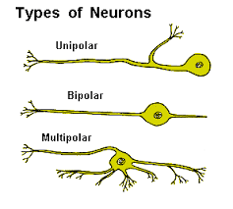
TYPES OF NEURON
Unipolar neuron
Bipolar neuron
Multipolar neuron

Slide 8
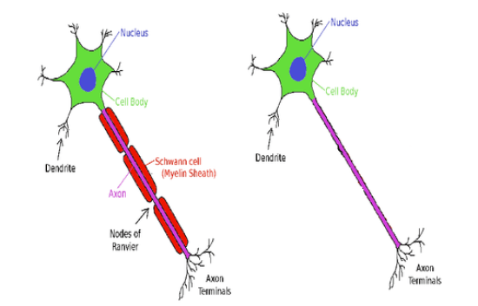
TYPES OF AXON
Myelinated axon Non-Myelinated axon

Slide 9
GENERATION AND CONDUCTION OF NERVE IMPULSES
Impulse transmission consists of 3 steps:
1.Maintenance of resting membrane potential
2.Action potential
3.Propagation of action potential

Slide 10
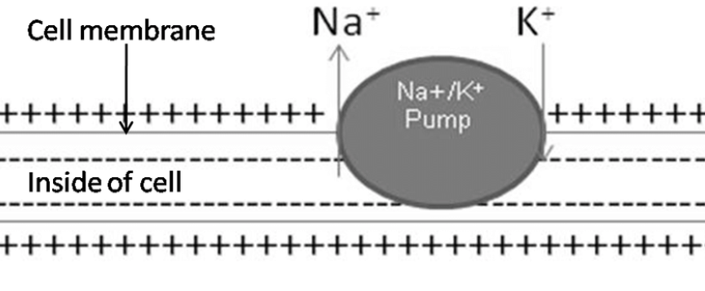
GENERATION AND CONDUCTION OF NERVE IMPULSES
1.Maintenance of resting membrane potential

Slide 11
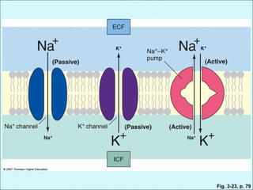
GENERATION AND CONDUCTION OF NERVE IMPULSES
1.Maintenance of resting membrane potential

Slide 12
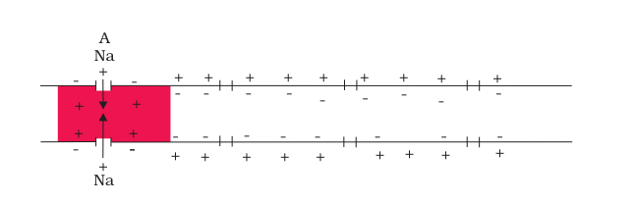
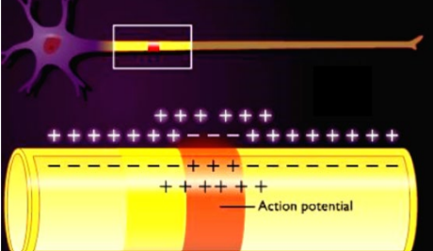
GENERATION AND CONDUCTION OF NERVE IMPULSES
2. Generation of Action potential

Slide 13
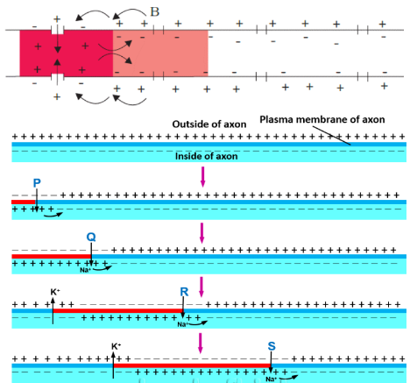
GENERATION AND CONDUCTION OF NERVE IMPULSES
3. Propagation of Action potential

Slide 14
SYNAPTIC TRANSMISSION OF IMPULSES
Synapse is a functional junction between two neurons.
It is 2 types:
    Electrical synapse
    Chemical synapse

Slide 15
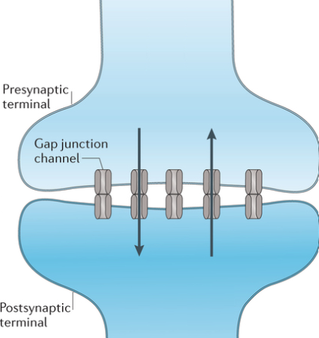
SYNAPTIC TRANSMISSION OF IMPULSES
Electrical synapse

Slide 16
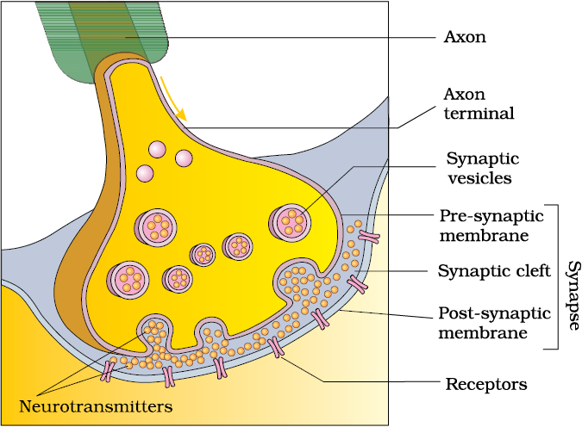
SYNAPTIC TRANSMISSION OF IMPULSES
Chemical synapse

Slide 17
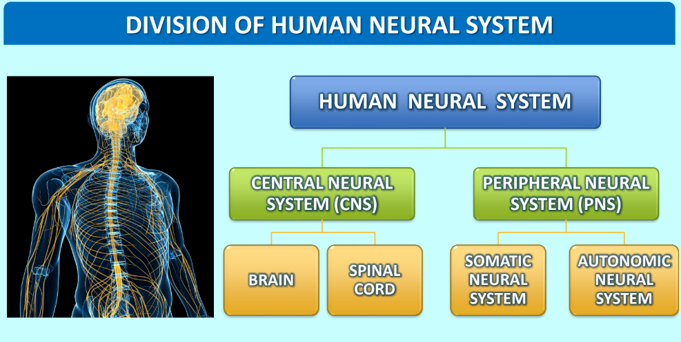

Slide 18
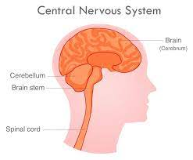
CENTRAL NEURAL SYSTEM
Consists of Brain and Spinal cord

Slide 19
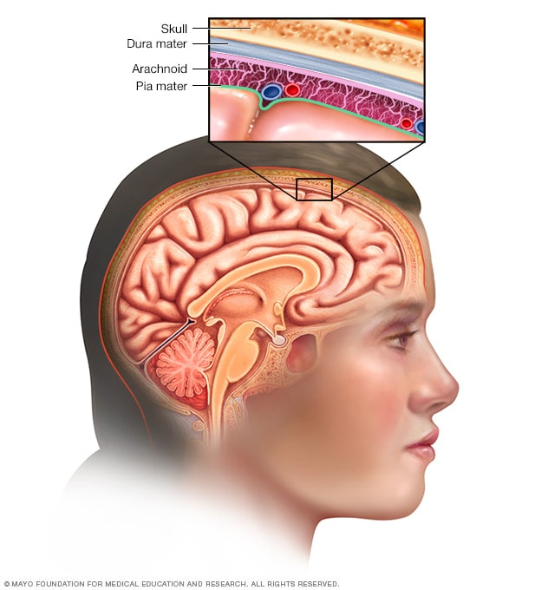
CENTRAL NEURAL SYSTEM
BRAIN

Slide 20
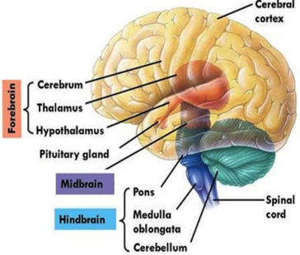
CENTRAL NEURAL SYSTEM
1. BRAIN
Brain has 3 divisions
  Forebrain (Prosencephalon)
  Midbrain (Mesencephalon)
  Hindbrain (Rhombencephalon)

Slide 21
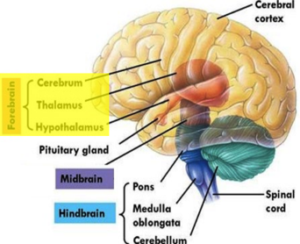
CENTRAL NEURAL SYSTEM
1. BRAIN
a. Forebrain (Prosencephalon)
It is the anterior part.
It consists of
  Cerebrum
  Diencephalon
  (Thalamus & Hypothalamus)

Slide 22
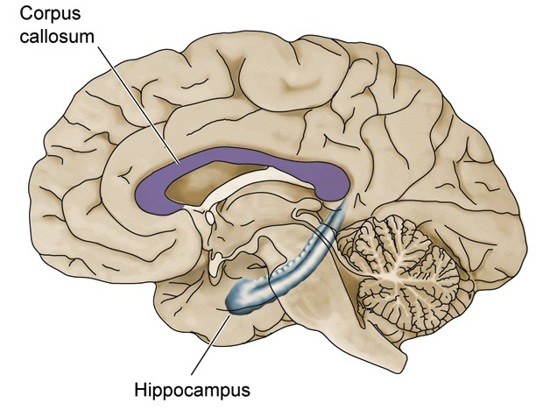
CENTRAL NEURAL SYSTEM
1. BRAIN
a. Forebrain (Prosencephalon)
CEREBRUM

Slide 23
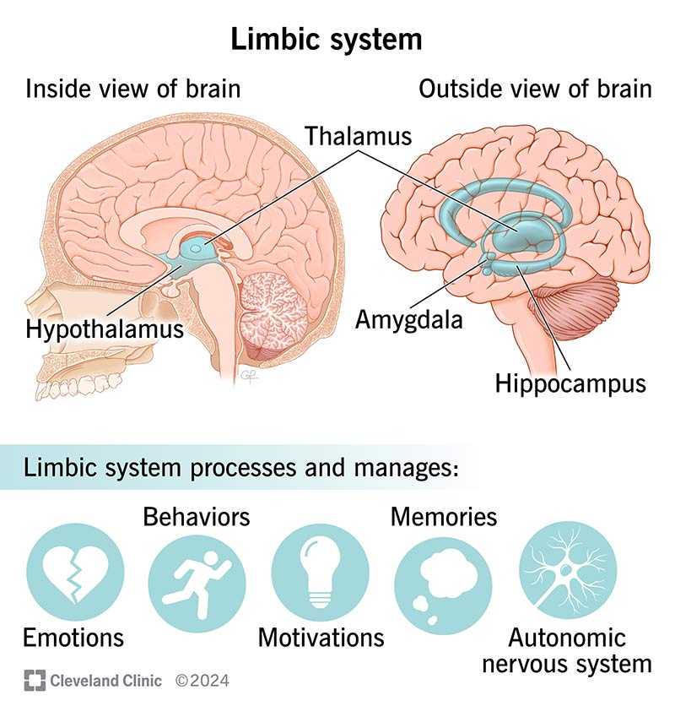
CENTRAL NEURAL SYSTEM
1. BRAIN
a. Forebrain (Prosencephalon)
CEREBRUM

Slide 24
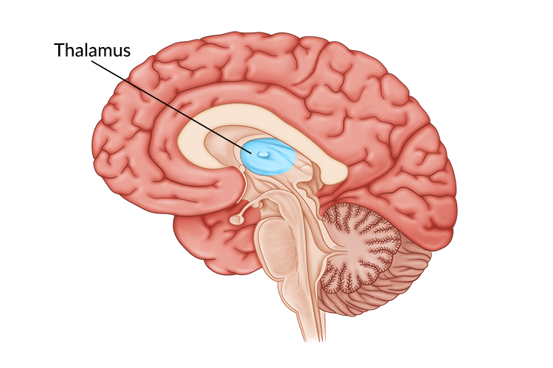
CENTRAL NEURAL SYSTEM
1. BRAIN
a. Forebrain (Prosencephalon)
DIENCEPHALON

Slide 25
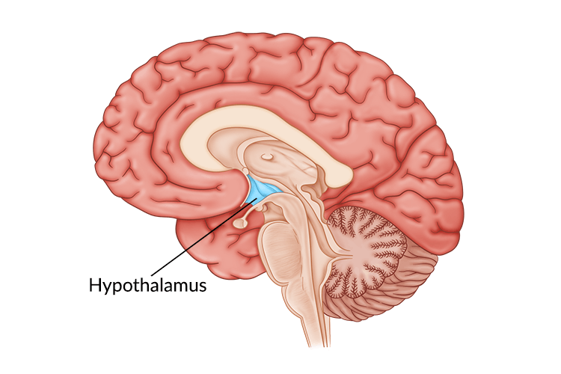
CENTRAL NEURAL SYSTEM
1. BRAIN
a. Forebrain (Prosencephalon)
DIENCEPHALON

Slide 26
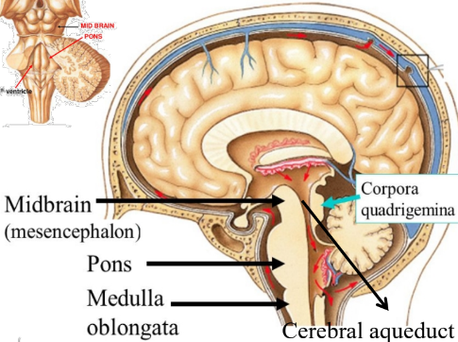
CENTRAL NEURAL SYSTEM
1. BRAIN
b. Midbrain (Mesencephalon)

Slide 27
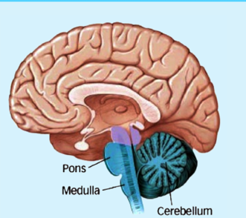
CENTRAL NEURAL SYSTEM
1. BRAIN
c. Hindbrain (Rhombencephalon)
It consists of
  Cerebellum
  Pons
  Medulla oblongata
  Midbrain & hindbrain form the Brain stem

Slide 28
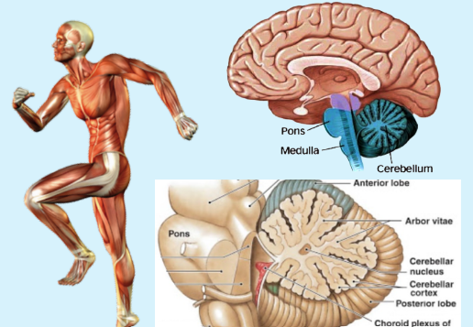
CENTRAL NEURAL SYSTEM
1. BRAIN
c. Hindbrain (Rhombencephalon)
CEREBRUM

Slide 29
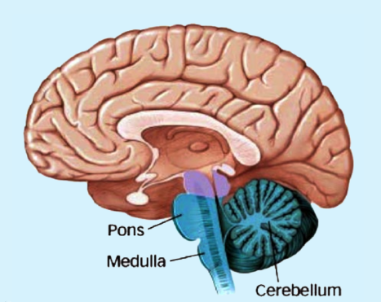
CENTRAL NEURAL SYSTEM
1. BRAIN
c. Hindbrain (Rhombencephalon)
PONS VAROLI

Slide 30
CENTRAL NEURAL SYSTEM
1. BRAIN
c. Hindbrain (Rhombencephalon)
MEDULLA OBLONGATA

Slide 31
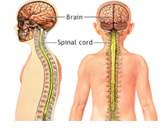
CENTRAL NEURAL SYSTEM
2. SPINAL CORD

Slide 32
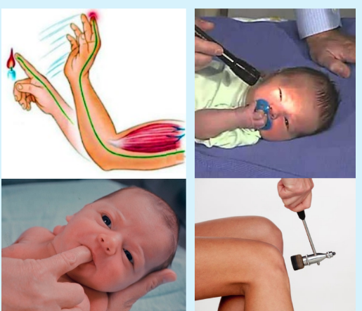
REFLEX ACTION
It is the rapid, involuntary and unconscious actions of body in response to a stimulus.

Slide 33
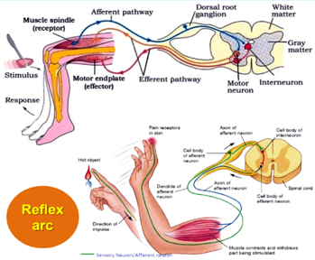
REFLEX ACTION
REFLEX ARC
The pathway of impulses in a reflex action is called Reflex arc. It consists of
1. A receptor organ : It receives stimulus.
2. Sensory (afferent) neuron : It transmits the impulses from sense organ to CNS.
3. Intermediate (connector) neuron : It connects sensory & motor neurons.
4. Motor (efferent/effector/excitor) neuron: It conducts impulse from the CNS to effector organ.
5. An effector organ (muscle/gland): It responds to impulse.

Slide 34
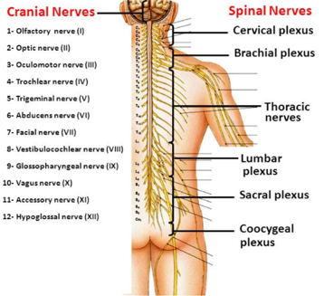
PERIPHERAL NEURAL SYSTEM (PNS)
It includes
  Cranial nerves
  Spinal nerves

Slide 35
PERIPHERAL NEURAL SYSTEM (PNS)
Nerve fibres of PNS are 2 types:
→ Afferent (sensory) fibres:
Carry impulses from sense organs to CNS
→ Efferent (motor) fibres:
Carry impulses from CNS to muscles and glands

Slide 36
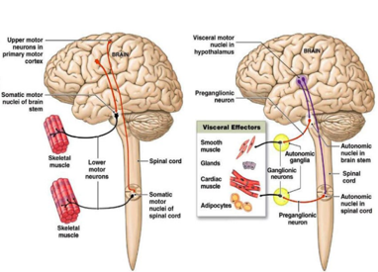
PERIPHERAL NEURAL SYSTEM (PNS)
PNS has 2 divisions
1. Somatic Neural System
2. Autonomic Neural System (ANS)

Slide 37
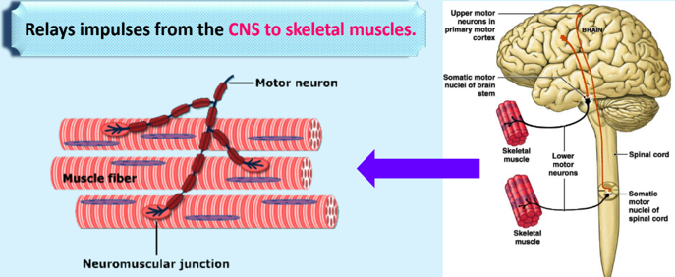
PERIPHERAL NEURAL SYSTEM (PNS)
1. SOMATIC NEURAL SYSTEM

Slide 38
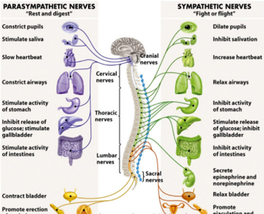
PERIPHERAL NEURAL SYSTEM (PNS)
2. AUTONOMIC NEURAL SYSTEM (ANS)
Transmits impulses from CNS to involuntary organs & smooth muscles.
ANS has 2 Parts
1. Sympathetic nerves
2. Parasympathetic nerves

Slide 39
1. The tract of nerve fibres which connects the cerebral hemisphere is
1. Corpus luteum 2. Corpus callosum
3. Corpora quadrigemina 4. Cerebral aqueduct
2. Thermoregulatory centre of human body is associated with
1. Cerebrum 2. Cerebellum
3.Hypothalamus 4. Medulla oblongs
In human, autonomic nervous system is composed of
1. Sympathetic and parasympathetic nerves
2. Carnial and spinal nerves
3. Brain and spinal nerves
4. Medullated and non-medullated nerves

Slide 40
The afferent nerve fibres transmit impulses
1. From tissues/organs to the CNS
2. From the CNS to the concerned peripheral tissues/organs
3. From the CNS t skeletal muscles 4. From one tissued to another
5. The Schwann sheath is
1. A non-myelinated nerve fibres 2. Associated with myelin sheath
3. A connective tissue cell
4. Associated with myelinated & non myelinated nerve fibre
6. The electrical potential difference across the plasma membrane at the site of depolarization is called
1. Graded potential 2. Resting potential
3. Action potential 4. None of the above

Slide 41
7. Nills’s granules are made up of?
1. Endoplasmic reticulum and mitochondria
2. Ribosome and Mitochondria
3. Ribosome and Endoplasmic Reticulum
4. Golgi body and Ribosome
8. Unmyelinated nerve, fibres, are commonly found in
1. Central; peripheral region 2. Autonomous; cranial region
3. Somatic; peripheral region 4. Autonomous; somatic region
9. The junction between the axon of one neuron and the dendrite of the next is called
1. A join 2. Constant bridge 3. Junction point 4. Synapse

Slide 42
10. Nerve impulse initiates with the
1. K⁺ 2. Na⁺ 3. Ca⁺ 4. Mg⁺
11. A polarized neuron is said to be in
1. Action potential 2. Resting potential
3. Spike potential 4. None of these
Unipolar neuron/unipolar nerve cells mean
1. Nerve cell with one dendron
2. Nerve cell with many dendrons
3. Nerve cell without dendrons
4. Neuron with one dendron and one axon

Slide 43
13. The membrane which covers the brain is called
1. White matter 2. Grey matter
3. Peritonium 4. Meninx
14. Which part of brain is supposed to be damage if in an accident a person lost control of water balance, hunger and body temp
1. Cerebellum 2. Hypothalamus
3. Medula oblongats 4. Corpora quadrigemina
The dorsal portion of midbrain consists mainly of rounded swellings called
1. Corpus callosum 2. Corpora quadrigemina
3. Corpus allatum 4. Cerebral aqueduct

Slide 44
16. Which statement is true?
1. In PNS, only non-myelinated neuron are found
2. In CNS, myelinated and non-myelinated neurons are found
3. In PNS, myelinated and non-myelinated neurons are found
4. Both (2) and (3)
17. Resting membrane potential is achieved by
1. Passive diffusion by ion channels/Leaky channels
2. Na—K⁻ ATPase pump
3. Negatively charged proteins in axoplasm 4. All of the above
18. Depolarization of axolemma during nerve conduction takes place because of
1. Neul amount of Na⁺ & K⁺ move out across axolemma
2. Na⁺ move inside 3. More Na⁺ outside 4. None

Slide 45
19. Neurons are excitable cells. This statement is best illustrated as
1. Different ionic channels are present on neural membrane
2. Ionic channels on neural membrane are selectively permeable
3. Neural membrane exists in a polarized state and responds to stimulus
4. Membrane is permeable to positive and impermeable to negatively charged ions

Slide 46
20. Pick out the correct combination
1. A-I, B-II, C-III 2. A-I, B-III, C-II
3. A-II, B-I, C-I 4. A-II, B-III, C-I
Column I |  | Column II
A | Unipolar neuron | I | In cerebral cortex
B | Bipolar neuron | II | In embryonies stage
C | Multipolar neuron | III | In retina of eye

Slide 47
21. The correct sequence of meninges of brain from outsides t inside is
1. durameter → arachnoid → piameter
2. arachnoid → durameter → piameter
3. piameter → durameter → arachnoid
4. durameter → piameter → arachnoid
22. Regulation of sexual behaviour is joint activity of
1. Only hypothalamus and cerebral cortex
2. Only thalamus and pons
3. Only thalamus and hypothalamus
4. Hypothalamus and limbic system

Slide 48
23. Which of the following statement is correct?
1. Dendrites possess Nissl’s granules
2. Schwann cell is found in unmyelinated neurons
3. Axoplasm is rich in proteins
4. Two of the above
Neural system of Hydra is
1. Simple type and consists of network of neurons
2. Complex type and consists of network neurons
3. Simple type and consists of many ganglia
4. Complex type and consists of many ganglia

Slide 49
25. What is correct about myelinated nerve fibres?
Schwann Cells Nodes of Ranvier
1. Present Present
2. Present Absent
3. Absent Absent
4. Absent Present
26. Which of the following statements are correct regarding Na⁺ - K⁺ pump?
i) Needs energy (ATP) to work
ii) Expels 3 Na⁺ for every 2K⁺ ions imported
iii) Works against a concentration gradient
iv) Maintains resting potential
1. (i) and (iv) 2. (ii) and (iii)
3. (i) and (iii) 4. All of these

Slide 50
27. Status of concentration of Na⁻,K⁻ and proteins in the axoplasm, respectively are
1. High, high, low 2. Low, high, low
3. Low, high, high 4. High, low, high
28. Which of the following is not related to electrical synapse?
1. Common type of synapse 2. Faster than chemical synapse
3. Fluid filled space between two neurons 4. Both (1) and (3)
29. In correct about association area is
1. Made up of myelinated tracts
2. Related with complex functions like memory
3. Confined to small areas in cerebrum
4. Neither purely motor non sensory

Slide 51
30. Action potential is generated at axonal membrane. All of the following are expected except
1. Outer surface of membrane will become negatively charged
2. Membrane is polarized
3. Membrane is nearly impermeable to K
4. Both (2) and (3) are not expected
31. Select the incorrect statement
1. Cerebellum is very much convoluted for more accommodation of neurons
2. Medulla is centre for cardio-vascular reflexes
3. Limbic system is involved in expression of emotional reactions and motivation
4. Afferent neuron ends at effector organ

Slide 52
32. Match the columns
1. A-1,2,3; B-5;C-4,6 2. A-1,2; B-4; C-3,5,6
3. A-2,3; B-4,5; C-1,6 4. A-2; B-4,6; C-3,5
Column A (Part of Brain) |  | Column B (Centre for)
A | Medulla | 1 | Cardiovascular reflexes
B | Hypothalamus | 2 | Gastric secretions
C | Cerebrum | 3 | Inter-sensory association
 |  | 4 | Body temperature
 |  | 5 | Memory
 |  | 6 | Communication

Slide 53
33. Which of the following is not the part of peripheral nervous system?
1. Somatic neural system 2. Sympathetic neural system
3. Spinal cord 4. Parasympathetic neural system
34. Which part of brain act as centre for following?
Body temperature |  | Gastric secretions
1 | Hypothalamus | Hypothalamus
2 | Medulla | Mid brain
3 | Cerebrum | Cerebrum
4 | Hypothalamus | Medulla

